Slide 1
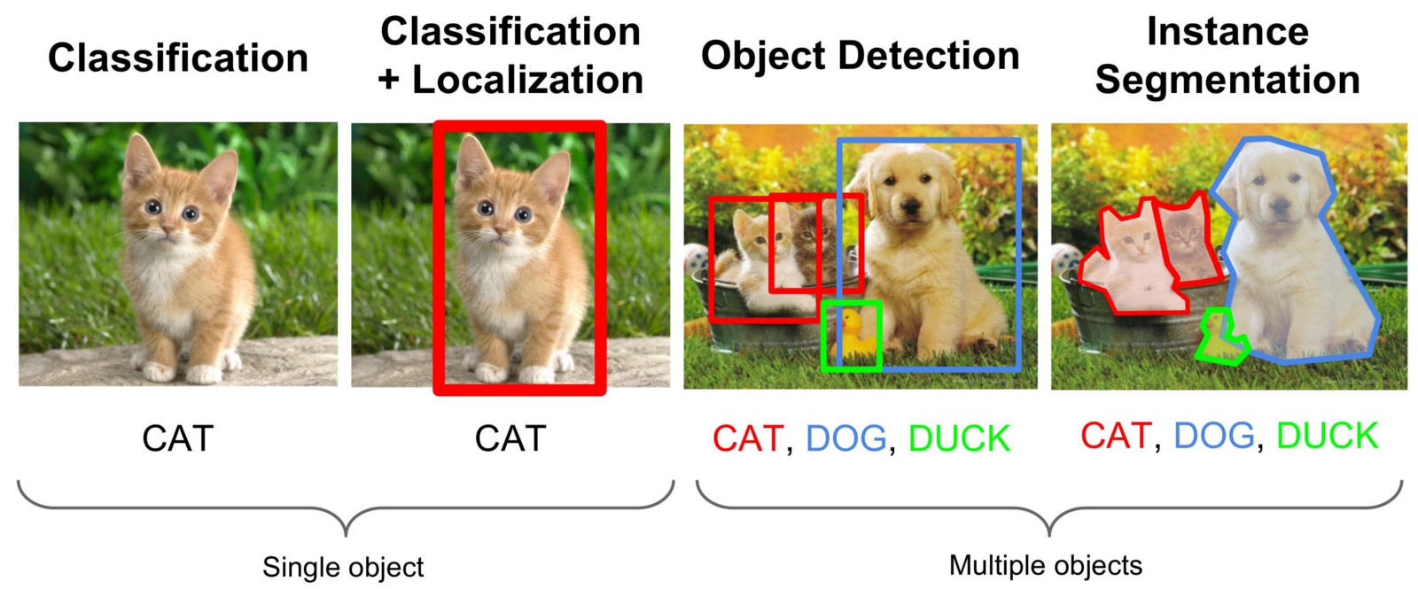
Benchmarking
Object detection & classification

Slide 2
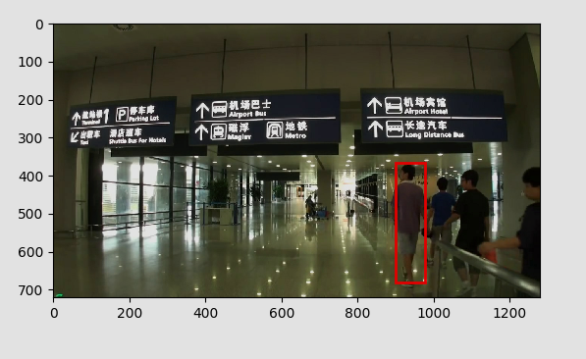
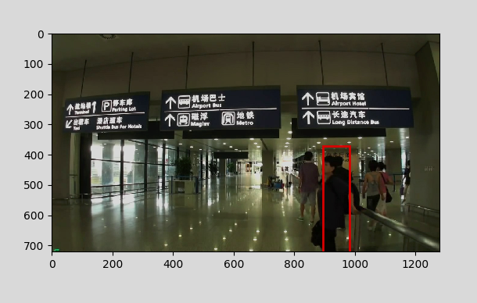
Object Tracking
Object tracking performance in 2D (RGB) was underwhelming - information in image ineffectively utilized
State of the art trackers required unjustifiable hardware and returned low processing speed ( < 5 FPS )
Still struggles in challenging scenes (human occlusion), due to lack of prior object knowledge and requirement to be able to track generic objects

Slide 3
Object detection & Classification
Given single frame (not video)
  Identify objects in image, assign class and bounding box
  Two popular challenges
    ImageNet challenge
    Microsoft COCO (Common objects in Context) challenge
Can they identify and locate objects of interest better than trackers, per frame?

Slide 4
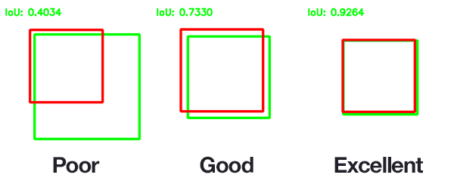
Object detection & Classification
Scored on average overlap (0.3/0.5/0.7)
Two datasets present same challenge essentially (object in image)
ImageNet has two main challenges
  Processing single images (not much use - not real-time)
  Video

Slide 5
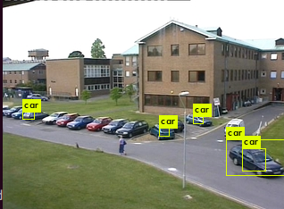
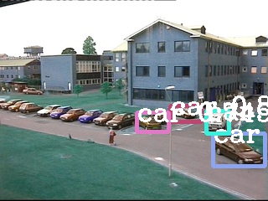
Object detection & Classification
Video
Two approaches
  Region of interest – accuracy, speed
  Single shot detectors – speed, accuracy
“State of the art” highly dependent on metric of IOU we choose (0.5 or 0.7)
YOLOv3 tiny (COCO) - speed Deep Feature Flow (ImageNet) - accuracy

Slide 6
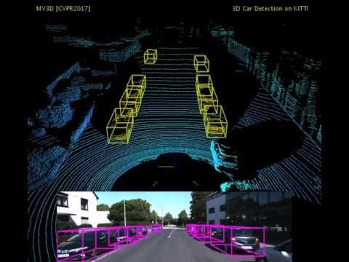
Object Tracking
Same hurdles as object tracking
  Not utilizing
    Depth information
    Prior knowledge
Next step – investigate RGBD & Point Clouds
Make use of available sensor data to improve accuracy/robustness
CAD model

